Slide 1
Dashboard Objective and KPIs
Objective:
To design an interactive dashboard that empowers business stakeholders to make informed decisions through analysis of sales, profit, and growth metrics.
KPIs: -Total Sales
- Total Profit
- Sales Growth Rate
- Profit Margin
- Average Order Value

Slide 2
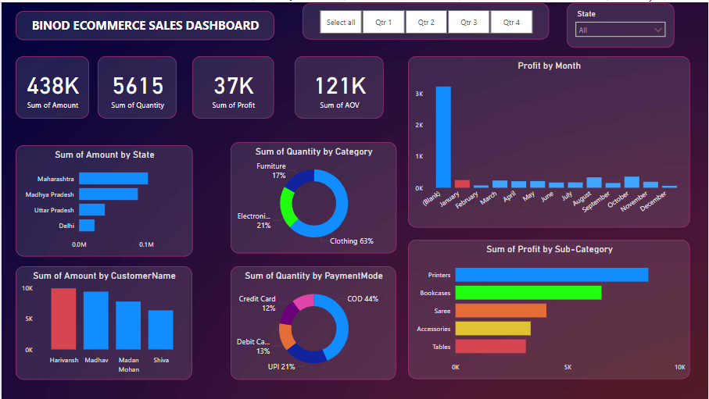
Dashboard Highlights
Dashboard Overview:
This slide will feature annotated screenshots of the dashboard, focusing on its interactive elements and visuals. Add arrows or labels to highlight key areas:
- Cards for Summary Totals: Display key performance indicators such as total sales and profit.
- Time-Series Analysis: A line or bar chart showing sales/profit trends over time.
- Category Distribution: Pie charts or bar graphs showcasing sales volume per product category.
- Regional Performance: Maps or charts comparing state-wise sales data.
- Customer Insights: Identify top revenue-generating customers or loyalty patterns.
- Filter Options: Showcase slicers to drill down by product type, region, or timeline.

Slide 3
Insights Derived
Key Business Insights:
- State Performance: Maharashtra leads in sales, indicating strong regional demand.
- Category Sales Analysis: Clothing accounts for the majority share, showing customer preferences.
- Time Insights: January displays peak profit activity, pointing towards seasonal impacts.
- Customer Trends: Harivansh ranks as the top revenue generator—indicating a loyal and valuable customer.
- Payment Preference: COD dominates as the preferred payment method, offering insights into customer buying behavior.
- Sub-Category Profit Insights: Printers emerge as the most profitable, guiding inventory strategies.

